Slide 1


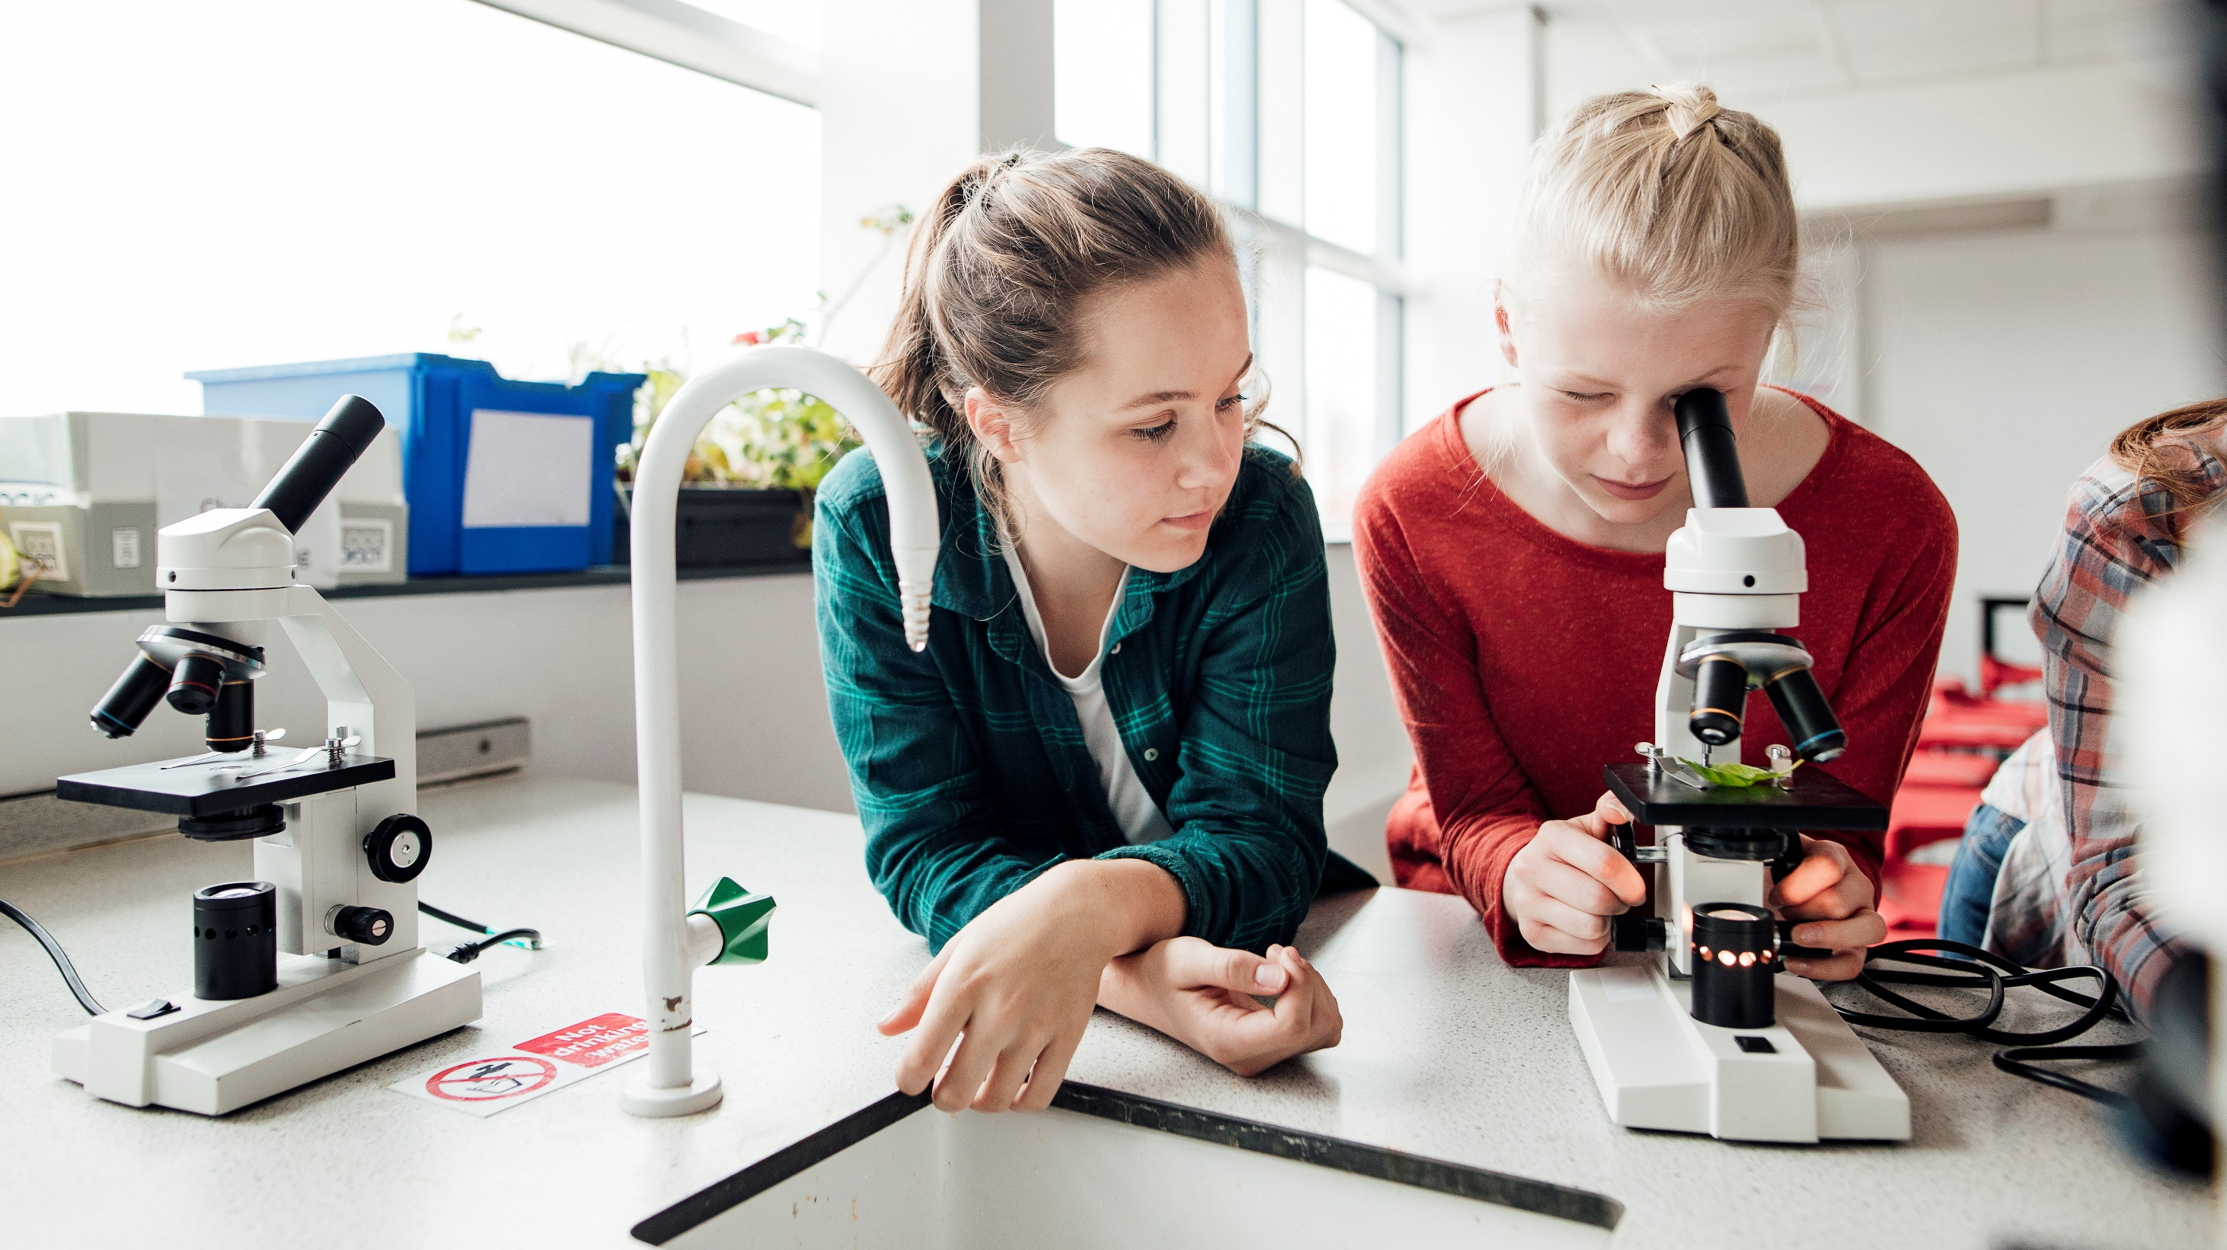
Welcome to
Year 4
2024

Slide 2
Staff
Miss Mead
Miss Burns

Slide 3

Weekly Timetable
Monday
Return reading books
Fruit money £1 donation
Guitars
Tuesday
Pe - leggings/joggers and a tshirt/ trainers
Friday
Reading books sent home
Park – Not on a set day (weather dependent)

Slide 4
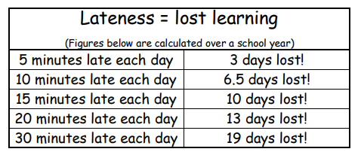
Attendance and punctuality
Article 28 – All children have a right to an education
School starts at 8.45am
All staff are in the yard from 8.35am
Punctuality is important
Lateness doesn’t just affect your child’s education

Slide 5
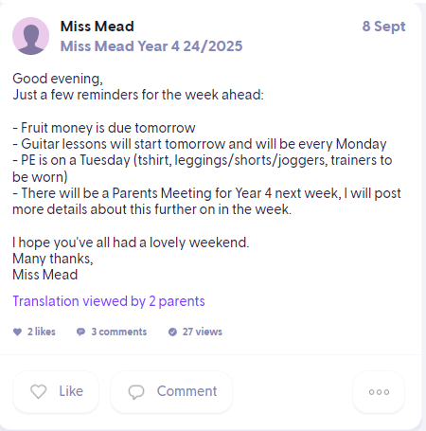
Class Dojo
All information regarding the class will be posted on class dojo
I will post regular photos of what we are learning about in class so you can chat to your children about their learning
All School information will be posted on school stories
If your child is to walk home, please let us know on class dojo

Slide 6

Reading
Crucial to your child’s learning
8 minutes every day
Child should still be read to
Book to be brought in every Monday
Encourage any type of reading
Individual and guided reading in school
Library Visits

Slide 7
Useful Links
TT Rockstars
Reading Eggs
500 words
Top Marks
Sum dog

Slide 8

School Trips
https://forms.office.com/Pages/ResponsePage.aspx?id=Ug4_TzS3ZEGUCRtgHRR5k20tG6dVliVEn4Vvs5UoO4hUNjhFMkhMRDI4NDZOTVdSM0pLQkdYTkRMWC4u
Our Community Trip – Wednesday 25th September
Pantomime –Tuesday 17th December – 10am

Slide 9

Independence

Slide 10
Clothing
Your child should have all items of clothing labelled.
School uniform
Important that your child wears suitable clothing – not flip flops/sliders
Bring a coat for a wet day

Slide 11
All About me passport
https://forms.office.com/Pages/DesignPageV2.aspx?prevorigin=shell&origin=NeoPortalPage&subpage=design&id=Ug4_TzS3ZEGUCRtgHRR5k5wAHwEq-4JIsG_TZEA5IU1UREw4WkhLSDc3RFpHSzJLRFI5SFBCNEc2Si4u
useful information about your child
confidential

Slide 12

Thank
You

